Slide 1
Chapter 2 part 4 Shuchi Jain, Virginia Commonwealth University
STAT441

Slide 2

Measures of Relative Standing
We've seen that numerical measures of central tendency and variation help describe the distribution of a quantitative data set.
In addition, you may want to describe the location of an observation relative to the other values in the distribution.
Two measures of the relative standing of an observation are percentiles and z-scores.

Slide 3
Percentiles
The 100pth percentile of a data set is a value of y located so that 100p% of the area under the relative frequency distribution for the data lies to the left of the 100pth percentile and 100(1 – p)% of the area lies to its right. (Note: 0 ≤ p ≤ 1.)

Slide 4
Percentiles
For example, if your grade in an industrial engineering class was located at the 84th percentile, then 84% of the grades were lower than your grade and 16% were higher.

Slide 5
Quartiles
The lower quartile, QL, for a data set is the 25th percentile.
The midquartile (or median), m, for a data set is the 50th percentile.
The upper quartile, QU, for a data set is the 75th percentile.

Slide 6
Percentile
To find the pth percentile,
calculate the quantity i = p(n + 1)/100 and round to the nearest integer.
The measurement with this rank, denoted y(i), is the pth percentile.

Slide 7
Example
A team of engineers conducted several experiments to measure the freckle index of a certain type of superalloy (Journal of Metallurgy, Sept. 2004). The data for n = 18 alloy tests is shown in Table. Create a stem-and-leaf display for the data and use it to find the lower quartile for the 18 freckle indexes.

Slide 8
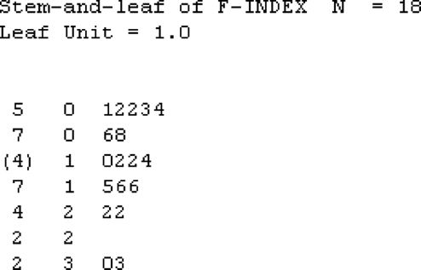
Stem and Leaf plot

Slide 9
Lower Quartile
Rounding up, we obtain ℓ = 5. Thus, the lower quartile, QL, will be the fifth observation when the data are arranged in order from smallest to largest.
This value corresponds to a freckle index of 4.1. Thus, for this small data set, QL = 4.1.

Slide 10

Z- score
The z-score for a value y of a data set is the distance that y lies above or below the mean, measured in units of the standard deviation:

Slide 11
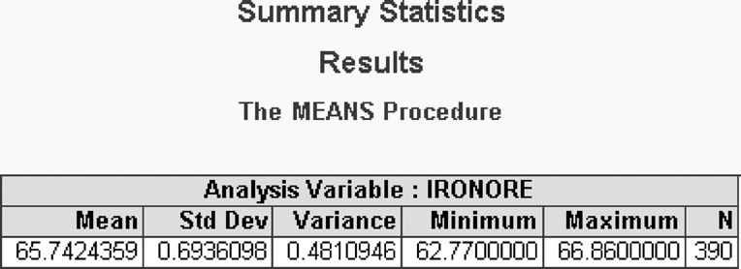
Example
Consider the data on percentage iron content for 390 iron-ore specimens. Find and interpret the z-score for the measurement of 66.56%.

Slide 12

The mean and standard deviation of the sample data are $\overline{y}=65.74$ and s = .69.
Substituting y = 66.56 into the formula for z, we obtain
Since the z-score is positive, we conclude that the iron content value of 66.56% lies a distance of 1.19 standard deviations above (to the right of) the sample mean of 65.74%.

Slide 13
Methods for Detecting Outliers
An observation y that is unusually large or small relative to the other values in a data set is called an outlier. Outliers typically are attributable to one of the following causes:
1. The measurement is observed, recorded, or entered into the computer incorrectly.
2. The measurement comes from a different population.
3. The measurement is correct, but represents a rare (chance) event.

Slide 14
Z score method to detect outliers
The most obvious method for determining whether an observation is an outlier is to calculate its z-score

Slide 15
Example
Refer to the sample data on 62 energy-related accidents worldwide since 1979 that resulted in multiple fatalities. In addition to the cause of the fatal energy-related accident, the data set also contains information on the number of fatalities for each accident. The first observation in the data set is a dam failure accident that occurred in India in 1979, killing 2500 people. Is this observation an outlier?

Slide 16
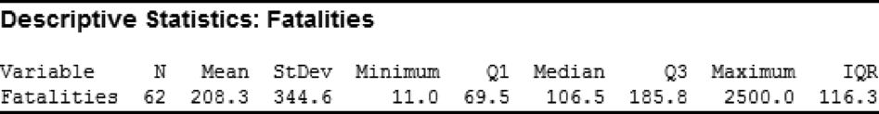
The Empirical Rule states that almost all the observations in a data set will have z-scores less than 3 in absolute value, while Chebyshev's Rule guarantees that at most (or, 11%) will have z-scores greater than 3 in absolute value. Since a z-score as large as 6.65 is rare, the measurement y = 2500 is called an outlier.

Slide 17
Z- score rules
z-Scores:
2 ≤ |z| ≤ 3 Suspect Outliers
z-Scores:
|z| > 3 Highly Suspect Outliers

Slide 18
Boxplot to detect Outliers
Another procedure for detecting outliers is to construct a box plot of the sample data.
The intervals are based on a quantity called the interquartile range instead of the standard deviation s.
The interquartile range, IQR, is the distance between the upper and lower quartiles:

Slide 19
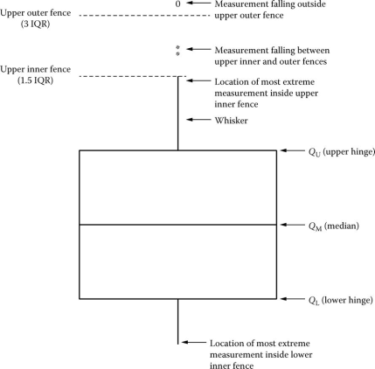
Elements of a Box Plot
1. A rectangle (the box) is drawn with the ends (the hinges) drawn at the lower and upper quartiles (QL and QU). The median of the data is shown in the box, usually by a line.

Slide 20

2. The points at distances 1.5(IQR) from each hinge mark the inner fences of the data set. Lines (the whiskers) are drawn from each hinge to the most extreme measurement inside the inner fence.

Slide 21

3. A second pair of fences, the outer fences, appear at a distance of 3 interquartile ranges, 3(IQR), from the hinges.

Slide 22


Slide 23
Outliers
Suspect Outliers : Data points between inner and outer fences
Highly Suspect Outliers : Data points beyond outer fences

Slide 24
Outliers
The z-score and box plot methods both establish rule-of-thumb limits outside of which a y value is deemed to be an outlier. Usually, the two methods produce similar results. However, the presence of one or more outliers in a data set can inflate the value of s used to calculate the z-score. Consequently, it will be less likely that an errant observation would have a z-score larger than 3 in absolute value. In contrast, the values of the quartiles used to calculate the fences for a box plot are not affected by the presence of outliers.

Slide 25
Distorting the Truth with Descriptive Statistics
A picture may be “worth a thousand words,” but pictures can also color messages or distort them. In fact, the pictures in statistics—histograms, bar charts, and other graphical descriptions—are susceptible to distortion, so we have to examine each of them with care.

Slide 26
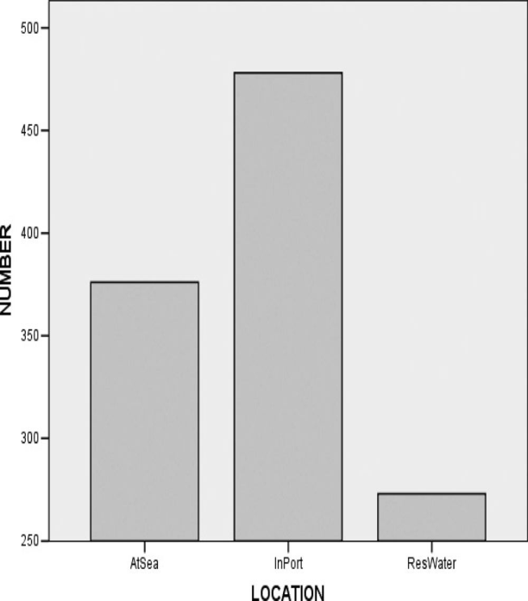
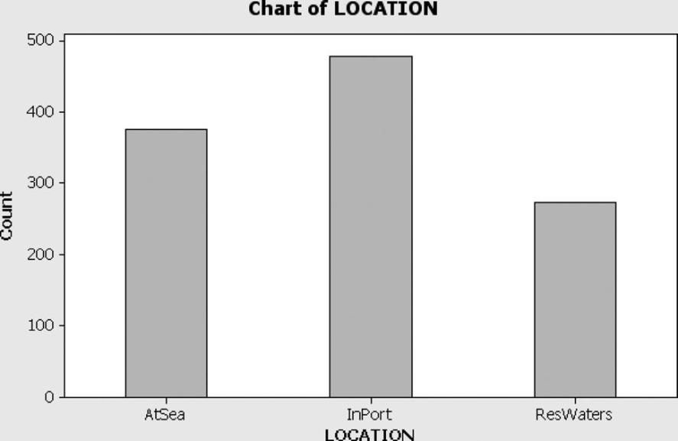
Changes in the axes
One common way to change the impression conveyed by a graph is to change the scale on the vertical axis, the horizontal axis, or both.
Collisions of Marine Vessels by Location

Slide 27
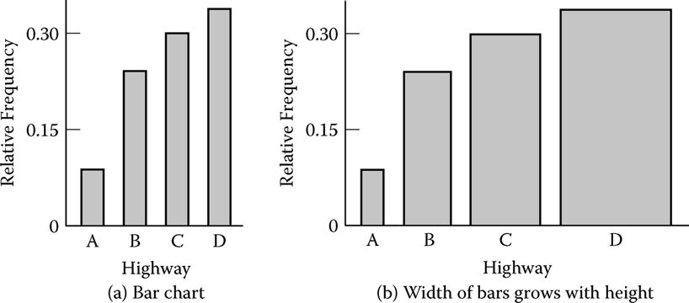
Visual changes
Ignore the visual changes and concentrate on the actual numerical changes indicated by the graph or chart.

Slide 28
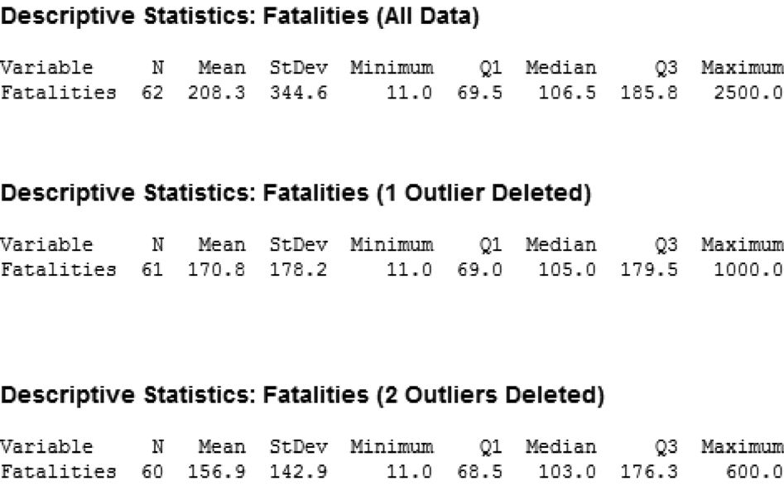
Impact of outliers

Slide 29
Another distortion of information in a sample occurs when only a measure of central tendency is reported. Both a measure of central tendency and a measure of variability are needed to obtain an accurate mental image of a data set.

Slide 30
For example, suppose the Environmental Protection Agency (EPA) wants to rank two car models based on their estimated (mean) EPA city mileage ratings.
model A has a mean EPA mileage rating of 32 miles per gallon
model B has a mean EPA mileage rating of 30 miles per gallon.

Slide 31
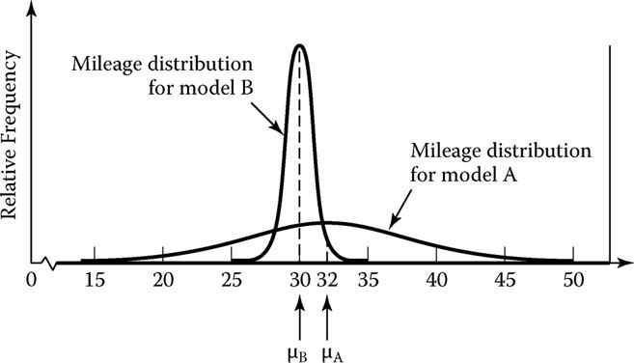

Slide 32
Note that the larger amount of variability associated with model A implies that a model A car is more likely to have a low mileage rating than a model B car. If the ranking is based on selecting the model with the lowest chance of a low mileage rating, model B will be ranked ahead of model A.

